Slide 1
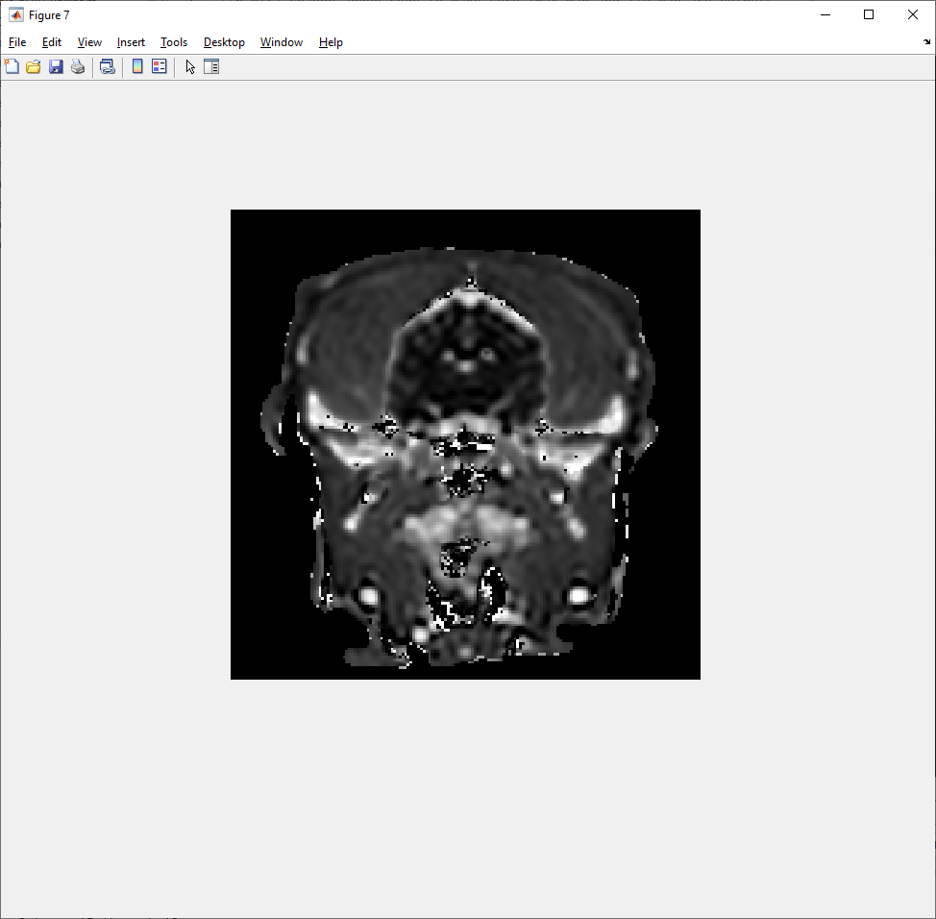
Load up the Results mat file, then:
>> figure;imshow(images{strcmpi(image_names,'T1map_pre')} - images{strcmpi(image_names,'T1map_post')},[0 1200])
Bright white spots are veins (usually these bigger ones are veins)
Choose one with best looking signal (see next slide)

Slide 2
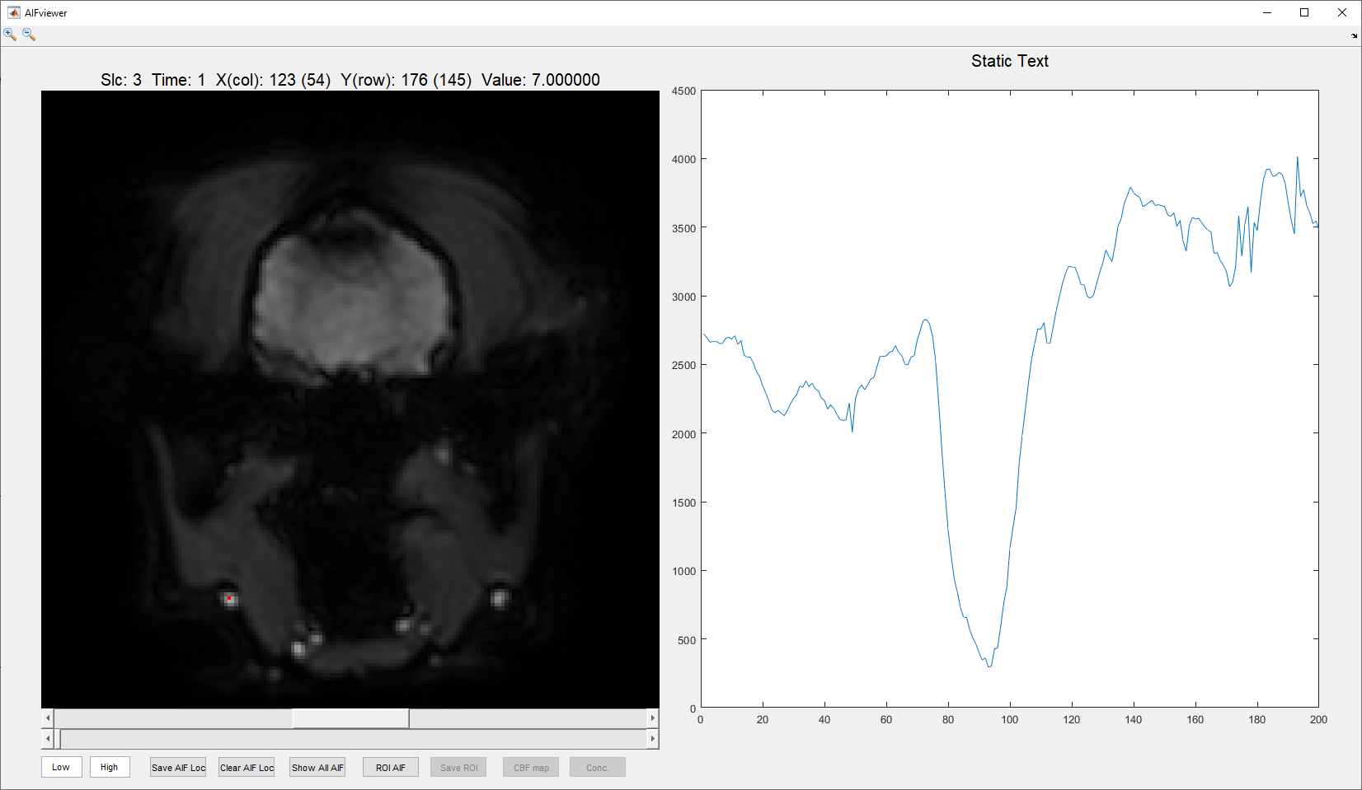
>> dsc = cat(4,ROIs.dsc_stack{:});
>> AIFviewer(dsc);
Check that the vein arrives late and looks fairly big
Compare to signal in brain (next slide)

Slide 3
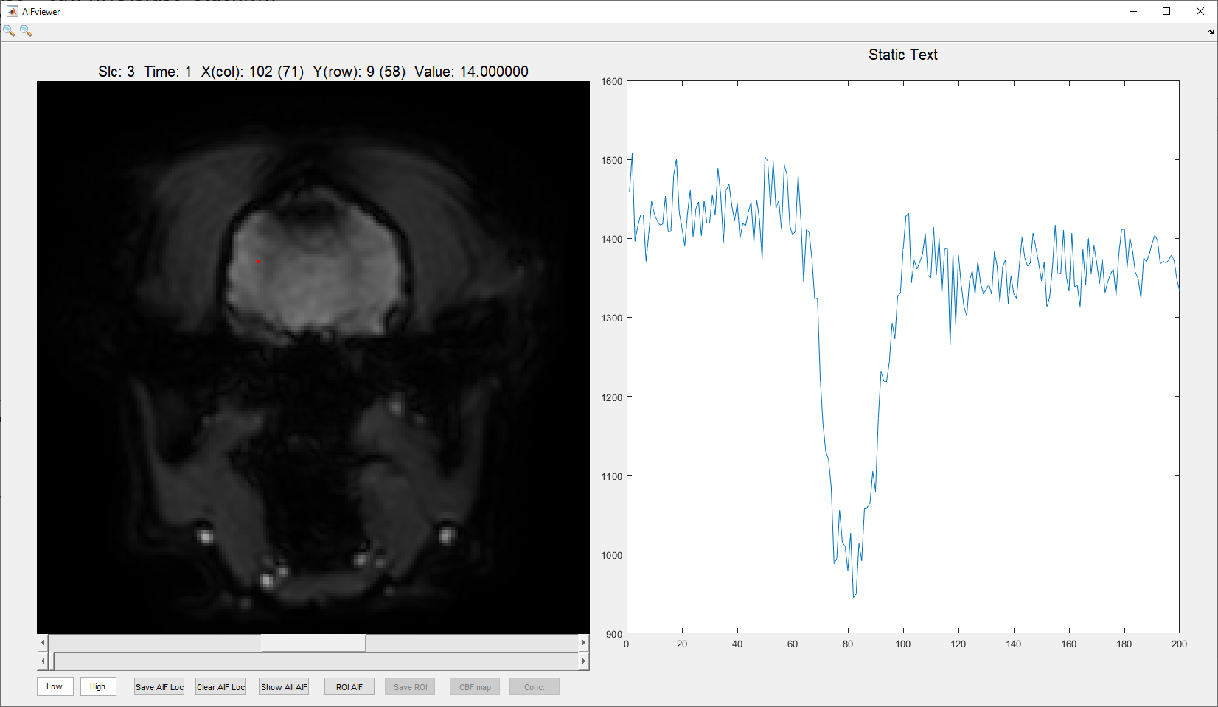
>> dsc = cat(4,ROIs.dsc_stack{:});
>> AIFviewer(dsc);
Compared to this signal in the parenchyma, the vein signal from previous slide arrives later

Slide 4
>> figure;imshow(images{strcmpi(image_names,'T1map_pre')} - images{strcmpi(image_names,'T1map_post')},[0 1200])
Draw mask
Save the mask as variable name ‘veinmask’. Then save the variable as mat file ‘Vein_Mask_P00#GE_M.mat’
veinmask = roipoly;
Save(path, ‘veinsmask’)

